Slide 1
MODULE III Understanding Natural Languages B.Tech.(AI), 6th Artificial Intelligence (CSE 401)
Amity School of Engineering and Technology

Slide 2
LEARNING OUTCOMES
Students will be able to know about NLP and basics of syntactic processing
Students will be able to understand parsing techniques
Students will be able to analyze a problem of Context free and transformational grammars

Slide 3
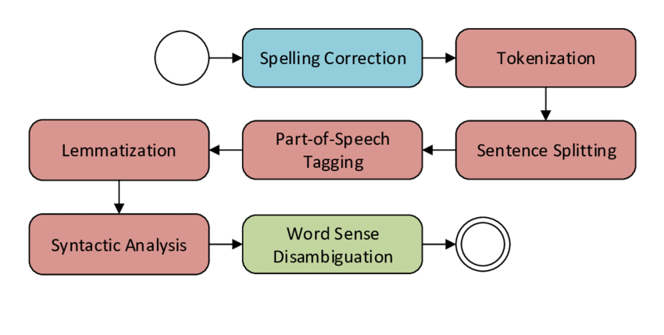
Processing information
Any expression carries huge amounts of information.
Any type of information can be interpreted.
Predicting human behaviour.

Slide 4
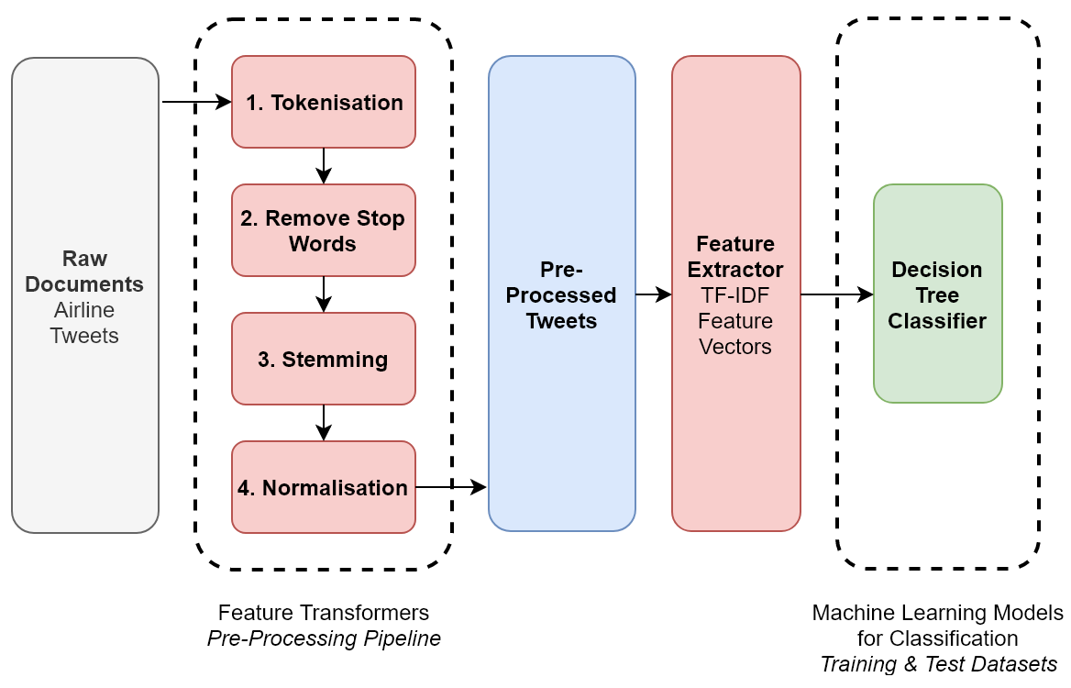
NLP Pipeline (Real-Time Classification of Airline Twitter Data)

Slide 5
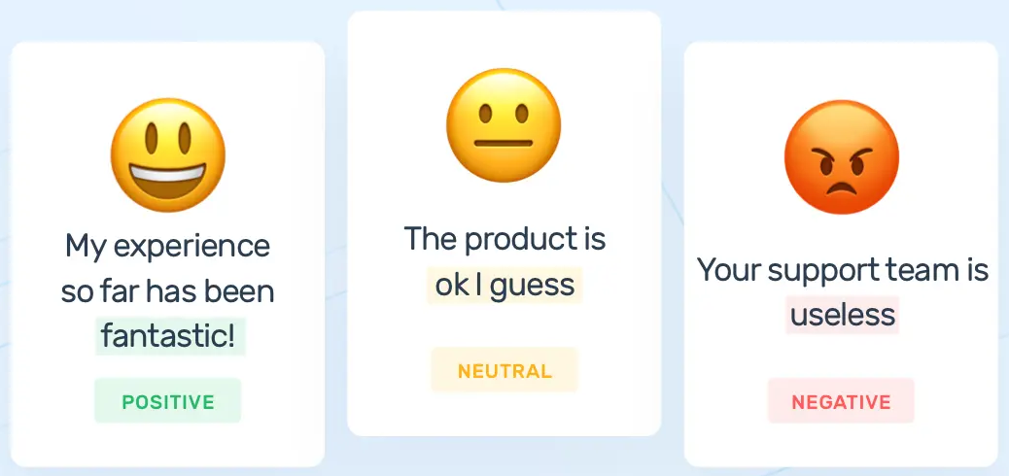
Major Challenge
One person may generate hundreds or thousands of words in a declaration.
Difficult to analyze millions of people of declarations.

Slide 6

Unstructured data
Examples: Conversations, declarations or even tweets.
Doesn’t properly fit into the structure of relational databases.
Hard to manipulate.

Slide 7
Definition & Use case
“Natural Language Processing or NLP is a field of Artificial Intelligence that gives the machines the ability to read, understand and derive meaning from human languages.”
Use Case: Automatic handling of natural human language like speech or text.

Slide 8
Examples
Recognition and prediction of diseases.
Determining customers’ opinion.
Personalized search engine.
E-mail classification.
Fake news identification.
Voice driven interfaces.
Financial trading.
Talent recruitment.
Litigation tasks

Slide 9
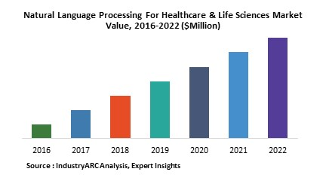
Boom in the healthcare industry
Enhancing care delivery.
Diagnosing disease.
Cutting costs.

Slide 10
NLP Basics
Major challenge:
Managing high complex languages.
Deciding different techniques to handle different challenges.
Deciding on the Programming languages to implement these techniques.

Slide 11
Traditional algorithms
Bag of Words
Allows counting all words in a piece of text.
Creates a occurrence matrix.
Occurrences are used as features for classifier training.

Slide 12
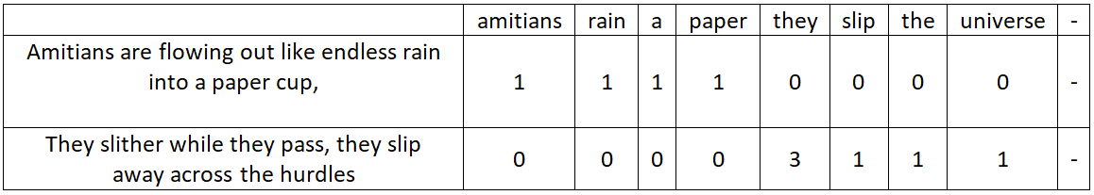
Bag of words
Amitians are flowing out like endless rain into a paper cup,
They slither while they pass, they slip away across the hurdles.

Slide 13
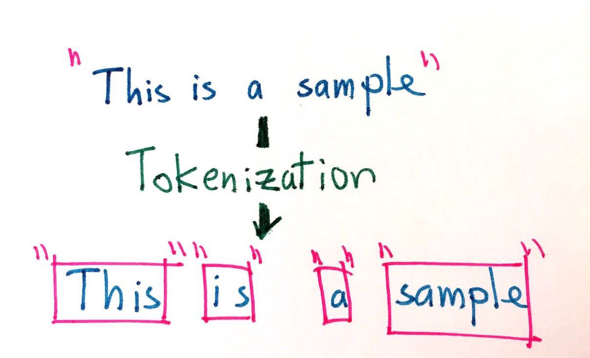
Tokenization
Segmentation of running text into sentences and words.
Cutting a text into pieces called tokens.
Removing certain characters, such as punctuation.

Slide 14
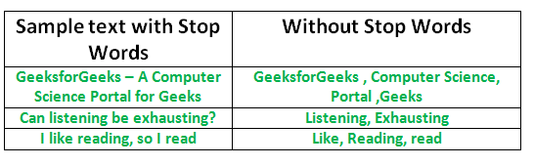
Stop Words Removal
Removing common language articles, pronouns and prepositions such as “and”, “the” or “to” in English.
Adopting pre-defined stop words.

Slide 15
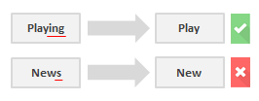
Stemming
Slicing the end or the beginning of words.
Intent of removing affixes.

Slide 16
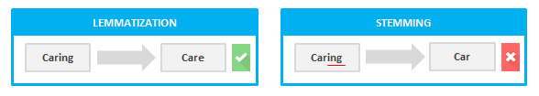
Lemmatization
Reduction of a word to its base form.
Grouping together different forms of the same word.

Slide 17
Topic Modeling
Uncovering hidden structures in sets of texts or documents.
Groups texts to discover latent topics.
Assumes each document consists of a mixture of topics and that each topic consists of a set of words.

Slide 18
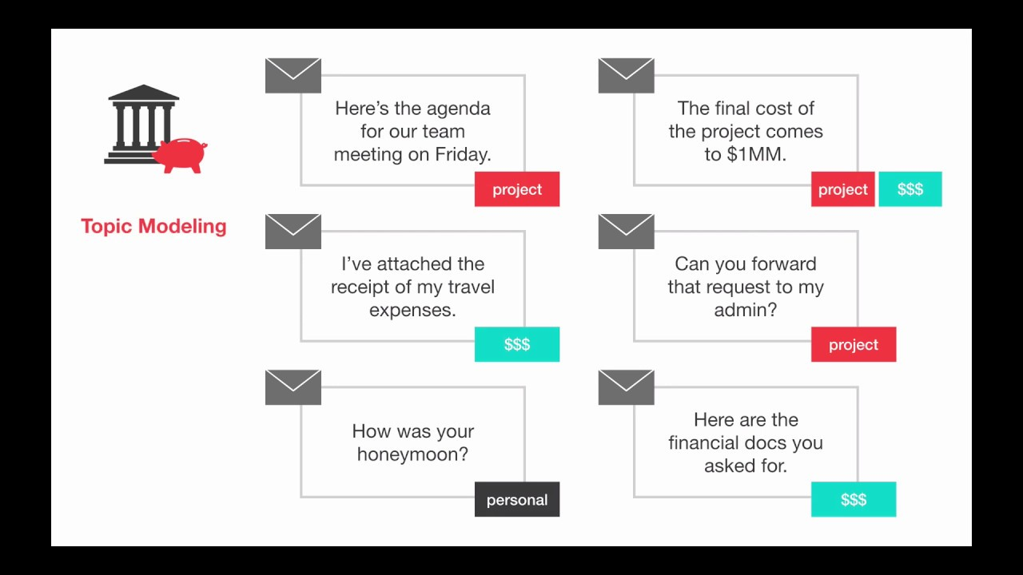
Topic Modeling (Example)

Slide 19
NLP future
Currently battling to detect nuances in language meaning.
On March 2016 Microsoft launched Tay, an Artificial Intelligence (AI) chatbot.

Slide 20
Syntactic Processing
Analyze the syntax or the grammatical structure of sentences.
Lexical analysis only aims at data cleaning and feature extraction using techniques such as stemming and lemmatization.
Syntactic analysis targets the roles played by words in a sentence.

Slide 21
Example
Amity is one of the best universities in India.
Is Amity the of one is in universities best.

Slide 22
Focus of syntactical analysis
Words order and meaning
Retaining stop-words
Morphology of words
Parts-of-speech of words in a sentence

Slide 23
Parsing
Breaking down a given sentence into its grammatical constituents.
Example:
“Who won the cricket worldcup in 2019?”
“The swift black cat jumps over the wall”

Slide 24
Part-of-speech (POS) tagging
According to the role of a word in a sentence, it can be tagged as a noun, verb, adjective, adverb, preposition, etc.
Correct tags such as nouns, verbs, adjectives, etc. should be assigned.

Slide 25
Constituency parsing
Need to identify and define commonly seen grammatical patterns.
Divide words into groups, called constituents, based on their grammatical role in the sentence.
Example:
‘Amitian — read — an article on Syntactic Analysis’

Slide 26
Dependency Parsing
Dependencies are established between words themselves.
Example:
‘Amitians attend classes’

Slide 27
Semantic Processing
Means getting the meaning of a text.
Different techniques are used in achieving this.

Slide 28
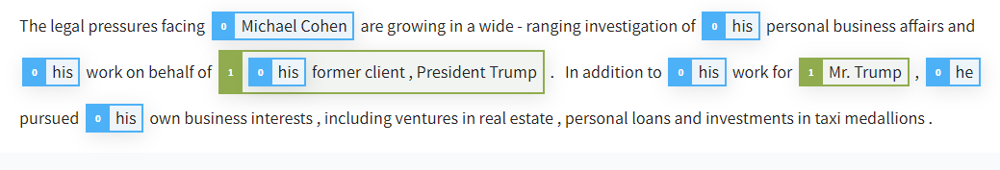
Co-reference resolution
Example:
Two entities as ‘Michael Cohen’ and ‘Mr. Trump’

Slide 29
Semantic role labeling
A sentence has a main logical concept conveyed named as the predicate.
The arguments for the predicate can be identified from other parts of the sentence.
The identification of the predicate and the arguments for that predicate is known as semantic role labeling.

Slide 30
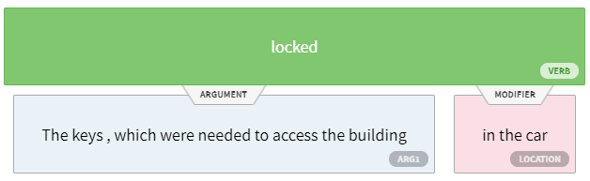
Semantic role labeling
Example:
“The keys, which were needed to access the building, were locked in the car.”

Slide 31
Word sense disambiguation
NLP involves resolving different kinds of ambiguity.
A word can take different meanings making it ambiguous to understand.
Word sense disambiguation (WSD) means selecting the correct word sense for a particular word.

Slide 32
Word sense disambiguation
Example:
The word “bank”. It can refer to a financial institution or the land alongside a river.
These different meanings are called word senses.
Context can be used effectively to perform WSD.

Slide 33

Named entity recognition
Identification of named entities such as persons, locations, organisations which are denoted by proper nouns.
Example:
“Michael Jordan is a professor at Berkeley.”

Slide 34
Context free grammars
It is the grammar that consists rules with a single symbol on the left-hand side of the rewrite rules. Let us create grammar to parse a sentence
“The bird pecks the grains”

Slide 35
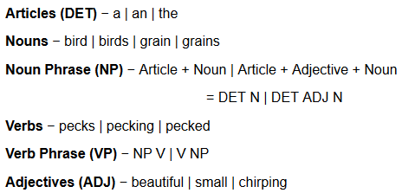
Context free grammars

Slide 36
Context free grammars
The parse tree breaks down the sentence into structured parts so that the computer can easily understand and process it.
In order for the parsing algorithm to construct this parse tree, a set of rewrite rules, which describe what tree structures are legal, need to be constructed.

Slide 37
Context free grammars
These rules say that a certain symbol may be expanded in the tree by a sequence of other symbols.
According to first order logic rule, if there are two strings Noun Phrase (NP) and Verb Phrase (VP), then the string combined by NP followed by VP is a sentence.

Slide 38
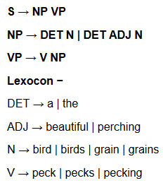
Context free grammars
The rewrite rules for the sentence are as follows −

Slide 39
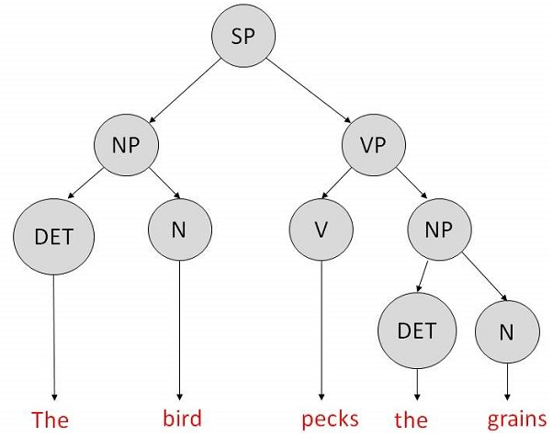
Context free grammars
The parse tree can be created as shown −

Slide 40
Some Examples
Mohan slept on the bench
The boy ate an apple
The green cow munched the grass.
Bill loves the Dog.

Slide 41
